Slide 1


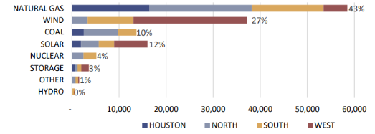
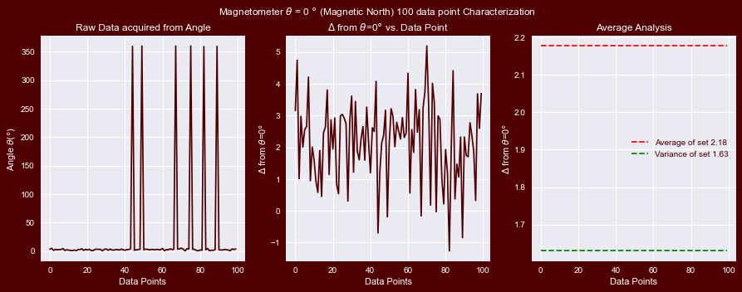
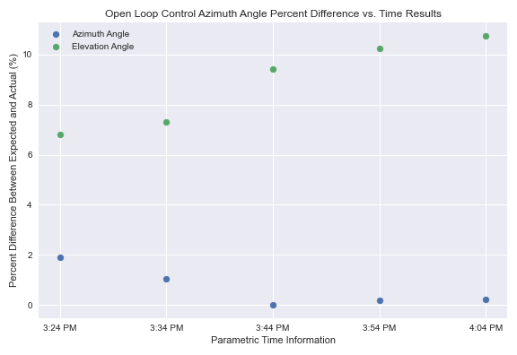
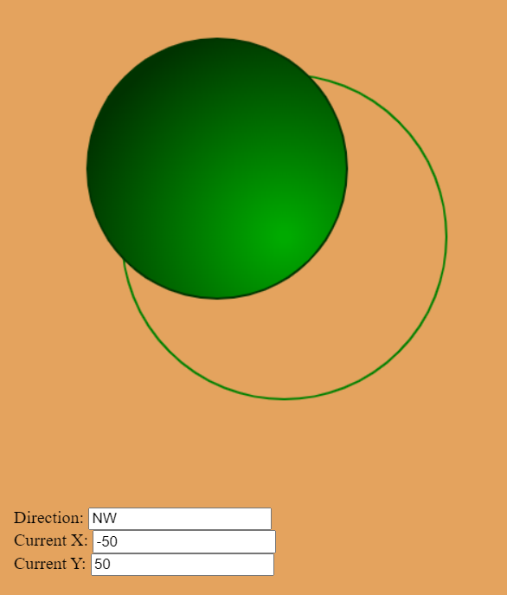
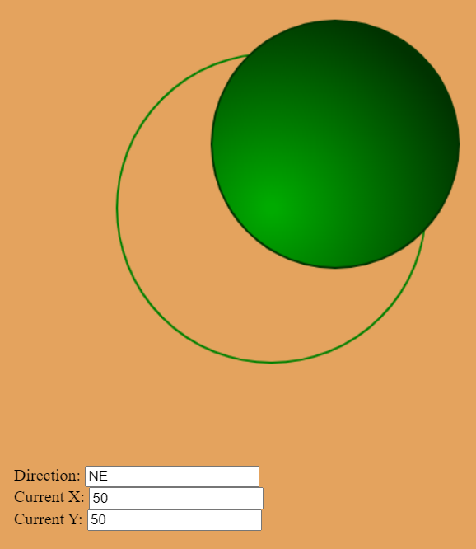
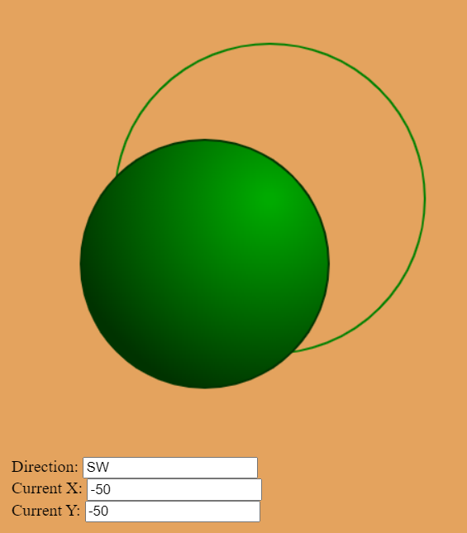
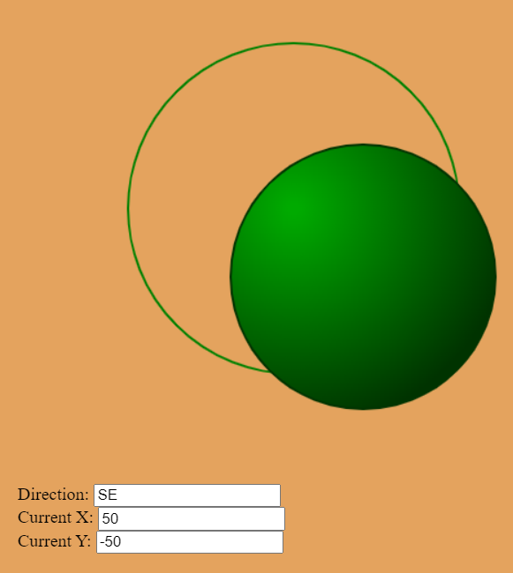
EPS Booth: 316
Fresnel Control Tracking
Jordan George, Samuel Dixon
Christy Madsen
Problem Definition
Engineering Analysis
Short-length serial communication for system feedback
Control Results for Azimuth and Elevation Tracking on a ten-minute interval basis for five sample points
Joystick Pulse-Width-Modulation encoded signal for wireless variable speed adjustment of system
Table 1. Caption in, 28 points, italicized.
There is a growing necessity for rapid change of energy source partition from non-renewable to renewable energy sources. This need is prompted from the basis of conscious consumption and environmental need. While there is apparent growth being made show in Figure 1, there is still significant room for improvement.
Chart Title
8.01 | 7.99 | 5.77 | 6.44
4.50 | 3.11 | 9.55 | 1.12
6.15 | 8.00 | 6.18 | 5.65
8.21 | 2.16 | 3.11* | 7.17
3.00 | 9.70 | 10.50 | 4.45
Mauris orci mi, varius id diam id, egestas auctor enim. Praesent ut massa nibh. Duis purus neque, facilisis cursus ultrices vel, ullamcorper ac augue. Donec semper lorem vitae urna pulvinar,.
Outcomes
Mauris orci mi, varius id diam id, egestas auctor enim. Praesent ut massa nibh. Duis purus neque, facilisis cursus ultrices vel, ullamcorper ac augue. Donec semper lorem vitae urna pulvinar,.
Sed in risus nibh. In nisl quam, aliquet sed nibh sit amet, faucibus placerat dui. Fusce quis augue scelerisque, luctus rum sed, porta ut dolor. In
Impact
Mauris orci mi, varius id diam id, egestas auctor enim. Praesent ut massa nibh. Duis purus neque, facilisis cursus ultrices vel, ullamcorper ac augue. Donec semper lorem:
Sed Risus Nibh: CiIn nisl quam, aliquet sed nibh sitamet, faucibus placerat dui augue scelerisque.
Curabitur Accumsan Nulla: Fusce quis augue urna scelerisque, luctus rum sed, ut dolor in pulvinar in eros.
Elementum Orci Dignissim: Proin semper ipsum finibus quam tempor, vitae.
Methodology
Hardware and Software
The system utilizes a custom-made PCB board with a Wifi ESP32 MCU to obtain key parametric information for solar tracking and sensor data collection. The ESP32 queries the STNP servers (System Time Network Protocol) for the corresponding time zone in college station). With this data and the local latitude and longitude readings, two angles are computed to actuate the control system.
Azimuth angle: bearing to adjust the system from magnetic north. ( Accomplished by rotation motor )
Elevation angle: angle to adjust the system to the new angle made with the ground ( Accomplished by linear actuator motor )
Data is monitored on a web application for system analysis and a manual control joystick is provided for alignment
Figure 1: Magnetometer reading results for magnetic north
Series 1
Series 2
Series: in et neque dignissim, and in aliquet nisl et umis.
Figure 2: Control Results for Azimuth and Elevation Tracking
Series 3
Scaled X-Axis duty cycle modulating rotation motor speed (%) | Scaled Y-axis duty cycle modulating elevation motor speed (%) | Rotational Motor Direction And Quadrant | Rotational Motor Direction And Quadrant
(50%)
Figure 4. Caption in, 28 points, italicized.
MAURIS ORCI MI VARIUS ID DIAM Egestas auctor enim. Praesent ut massa nibh. Duis purus neque, facilisis cursus ultrices vel, ullamcorper ac augue. Donec semper lorem. Mauris orci mi, varius id diam id, egestas auctor enim. Praesent ut massa nibh. Duis purus neque, facilisis tristique quis augue scelerisque.
References
Phasellus nec lectus bibendum, posuere nibh id, lacinia
Mauris orci mi, varius id diam id, egestas auctor enim
Duis vitae tincidunt tortor, vitae sollicitudin magna
Aenean et est sem. Phasellus nec lectus bibendum
Lacinia magna. Mauris orci mi, varius id diam id, egestas
Mauris orci mi, varius id diam id, egestas auctor enim
Duis vitae tincidunt tortor, vitae sollicitudin magna
Figure 3: Control Results for Azimuth and Elevation Tracking
Table 1: Conversion and Control Factors
Acknowledgements
Acknowledgments in Arial, 24 points, try to keep to one or two lines,
Figure 1. System Level Design

